Slide 1
ICT90003 Applied Research Methods Kim Hodgman FSET librarian khodgman@swin.edu.au
CRICOS 00111D TOID 3059

Slide 2
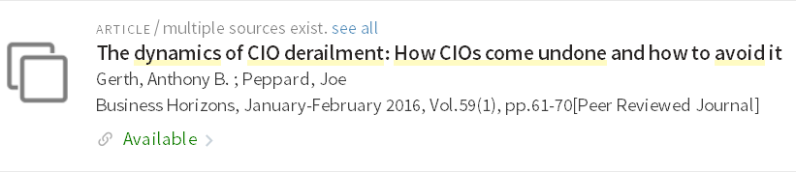

Find a citation – search article title on the library homepage
Gerth, AB & Peppard, J 2016, 'The dynamics of CIO derailment: How CIOs come undone and how to avoid it', Business Horizons, vol. 59, no. 1, Jan-Feb, pp. 61-70.

Slide 3


Find a citation – search journal name on the library home page
Gerth, AB & Peppard, J 2016, 'The dynamics of CIO derailment: How CIOs come undone and how to avoid it', Business Horizons, vol. 59, no. 1, Jan-Feb, pp. 61-70.

Slide 4
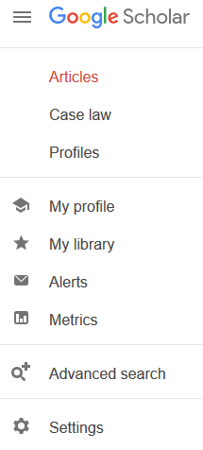
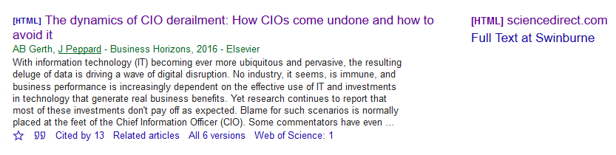
Find a citation – search article title in Google Scholar (save preferences first)
For direct access to Swinburne Library collections at home go to Google Scholar Settings > Library Links > Search for Swinburne > click Save.

Slide 5
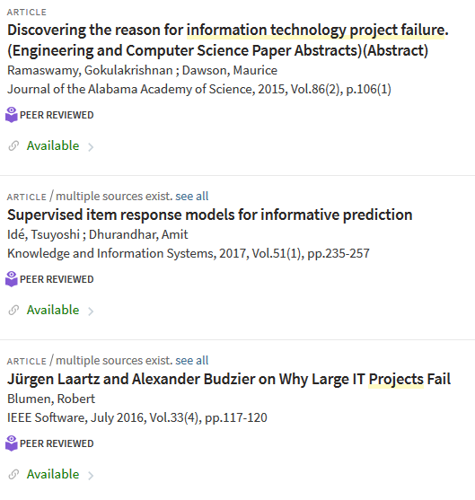
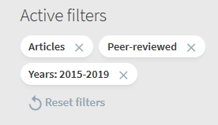
Find peer-reviewed journal articles: search the library: information technology project failure

Slide 6
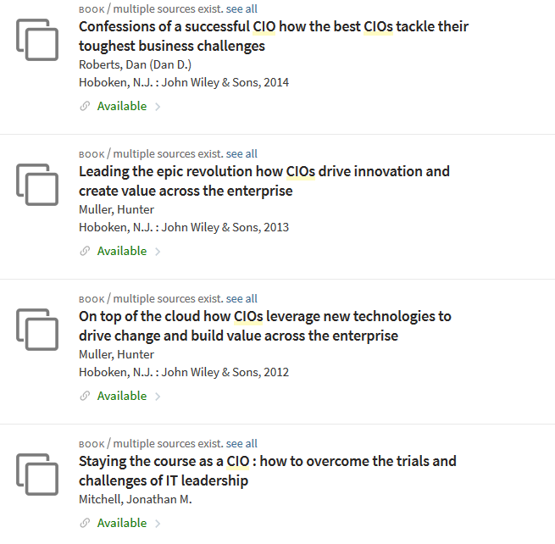
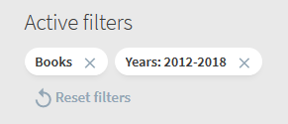
Find books: search the library: chief information officers or cios

Slide 7
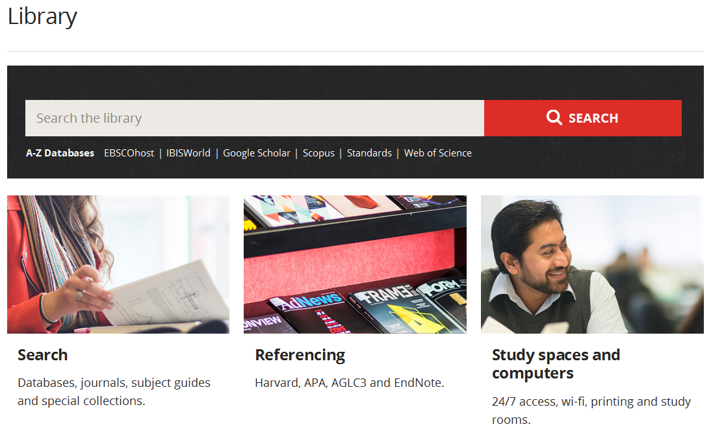
A-Z databases list
www.swinburne.edu.au/library/

Slide 8

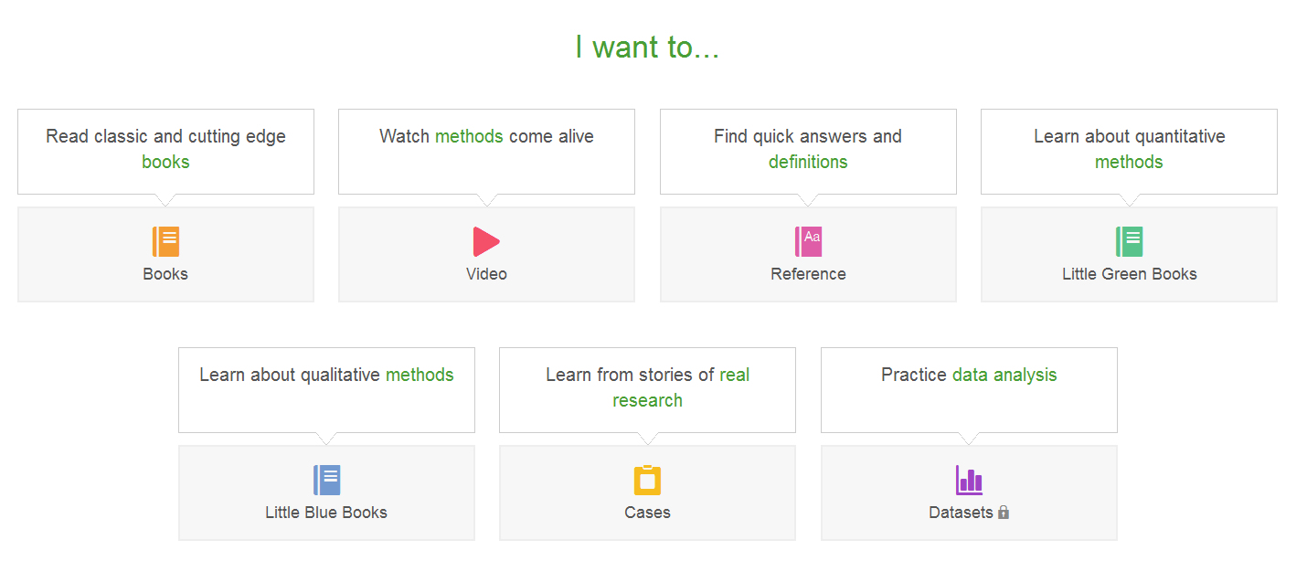
Sage Research Methods Online

Slide 9
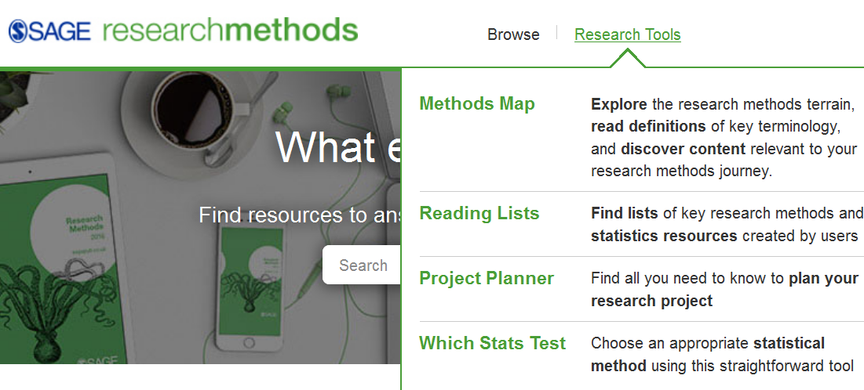
Sage Research Methods Online – project planner

Slide 10
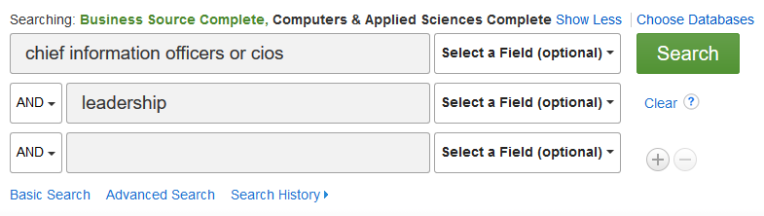
Search EBSCOhost databases: Business Source Complete Computers & Applied Sciences Complete
Advanced search: chief information officers OR cios AND leadership

Slide 11
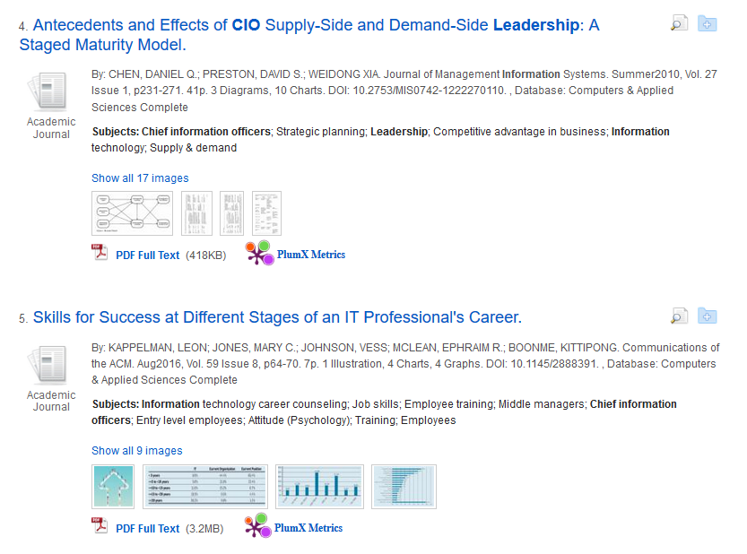
Search results list

Slide 12
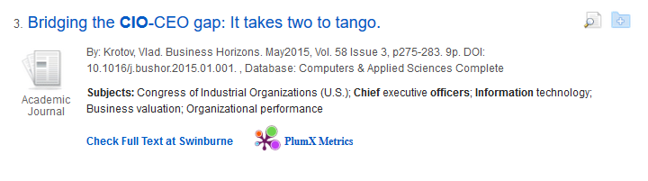
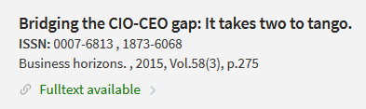

Check Full Text at Swinburne

Slide 13
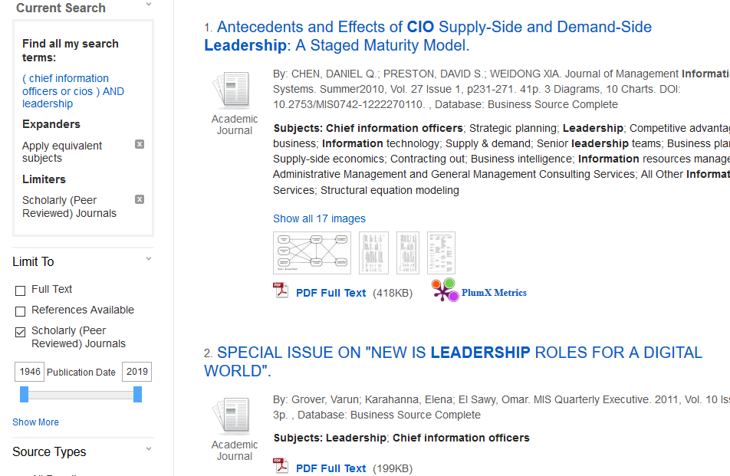
Find scholarly (peer-reviewed) articles

Slide 14
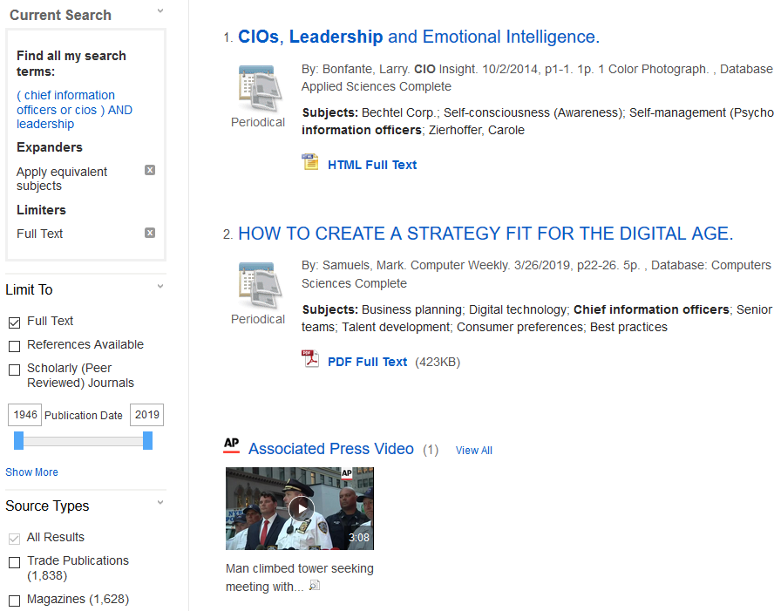
Limit to full text

Slide 15
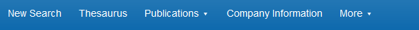
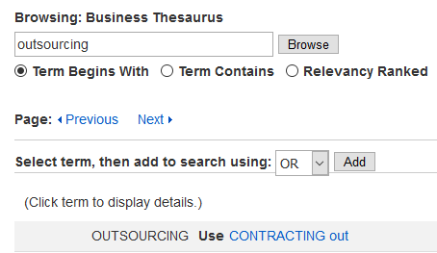
Use the thesaurus

Slide 16
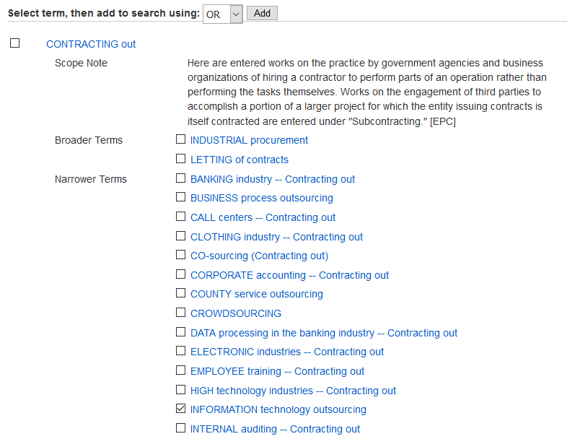
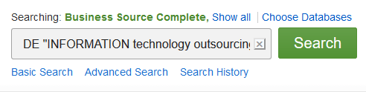
Search thesaurus subject terms

Slide 17
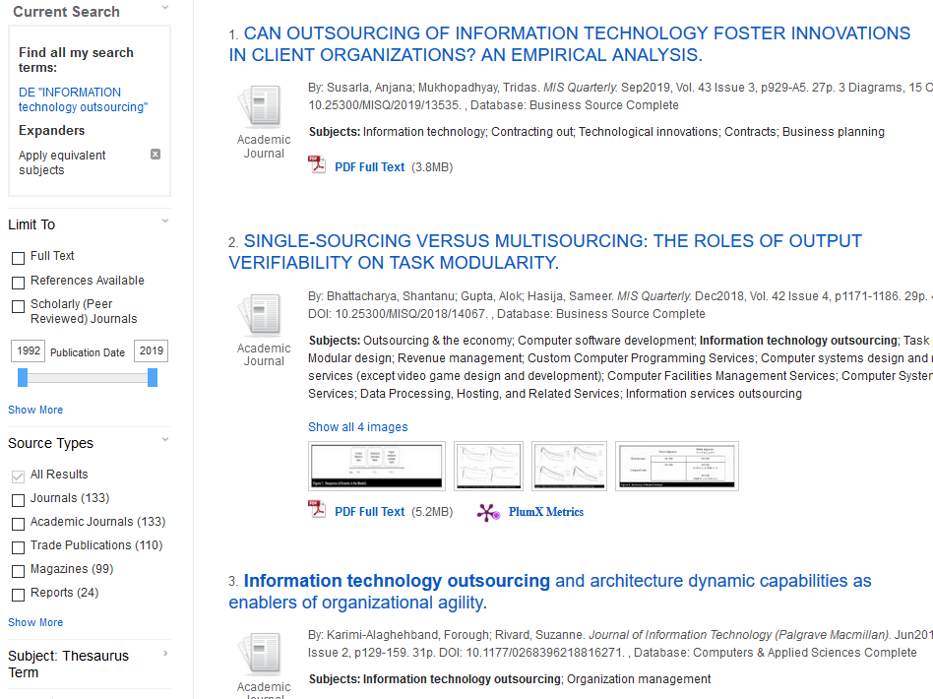
Results list with subject terms

Slide 18
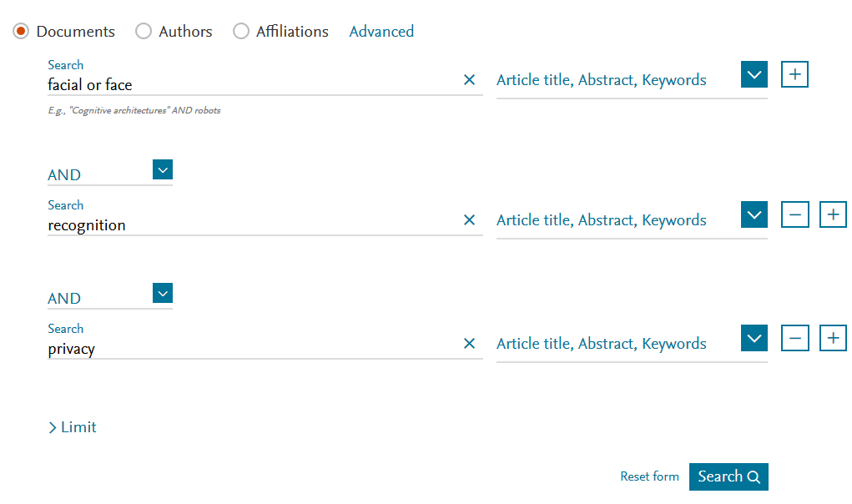
Search a database: Scopus

Slide 19
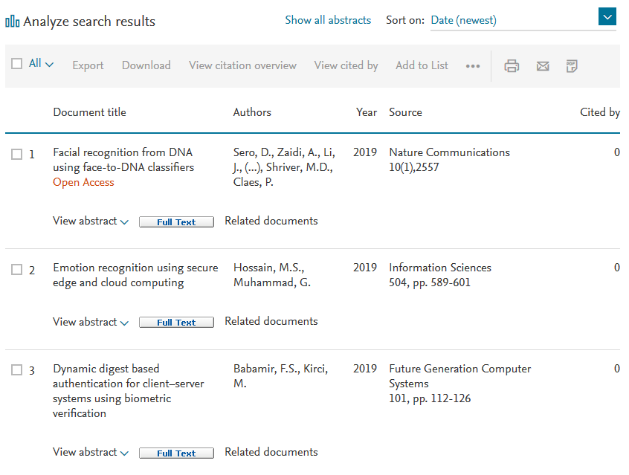
Search results list

Slide 20
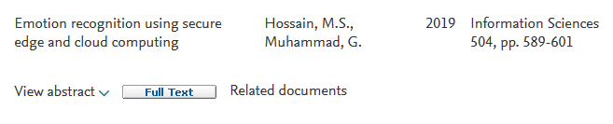
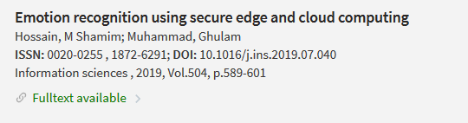

Find the paper – click Full Text

Slide 21
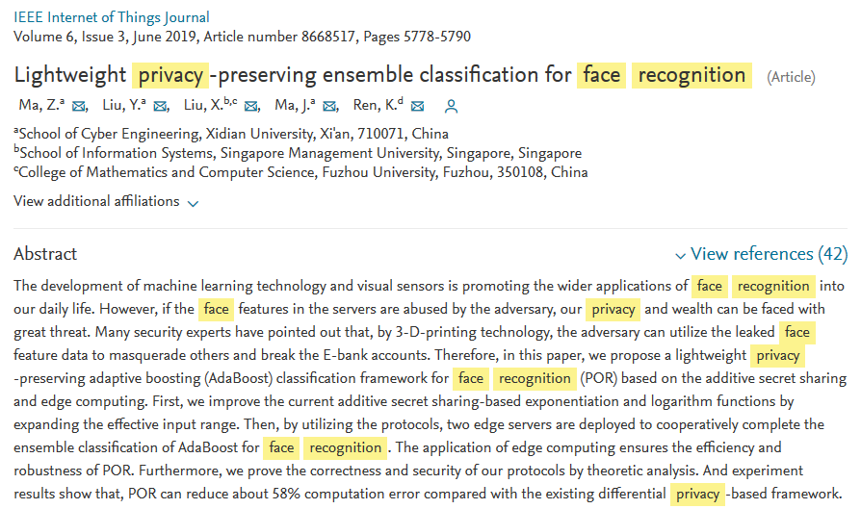
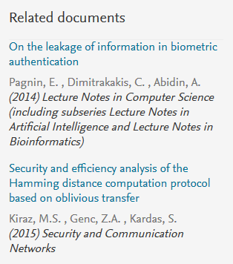
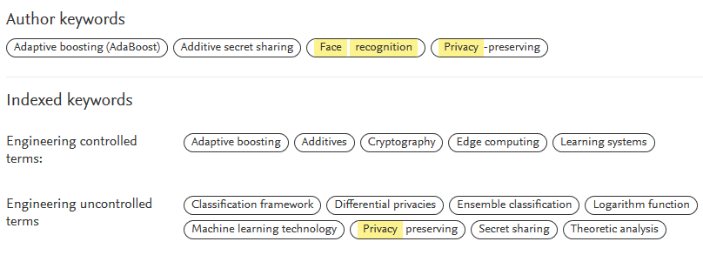
Open a reference to see related documents, references and keywords

Slide 22
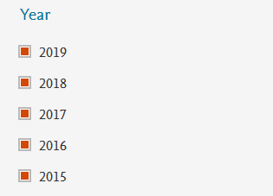
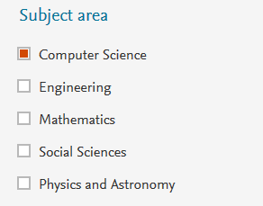
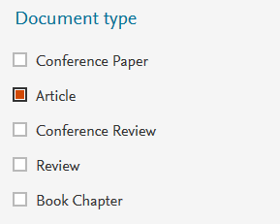
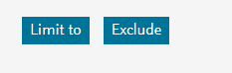
Refine a search: use options on the left: for example

Slide 23
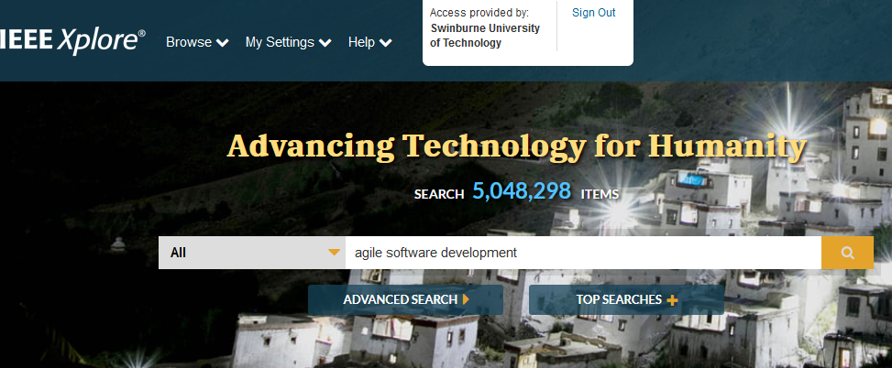
Search a database: IEEEXplore

Slide 24
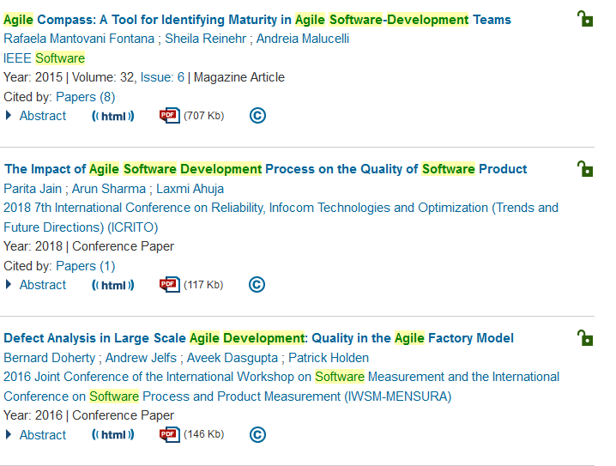
IEEEXplore results list and pdfs

Slide 25
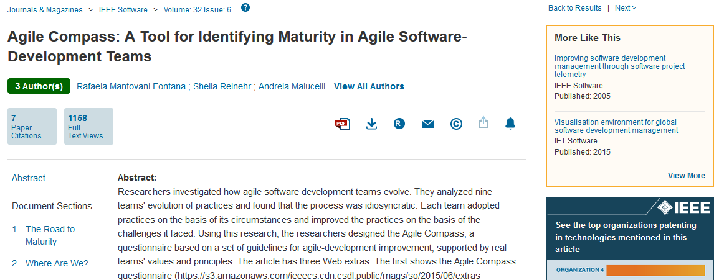
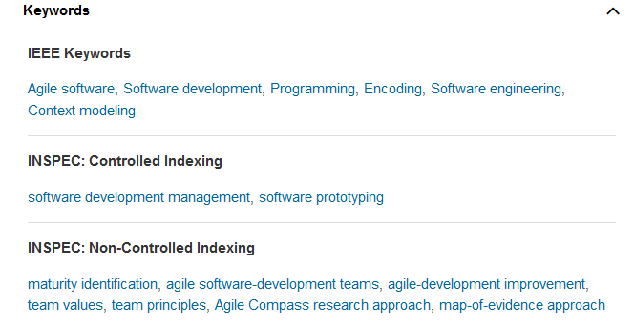
IEEEXplore – (searchable) keywords and more like this

Slide 26
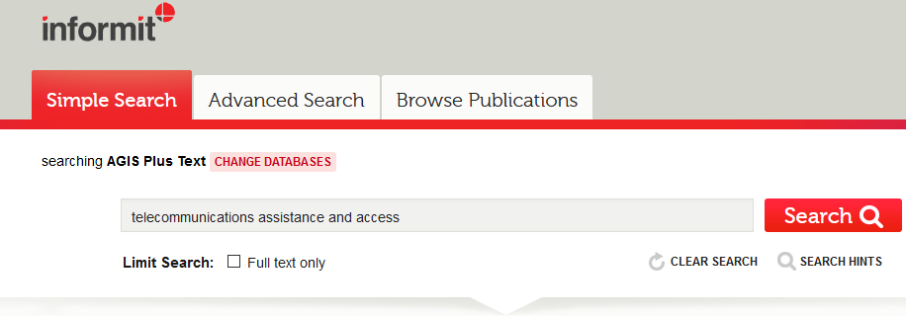
Search a database: AGIS Plus Text (Attorney General’s Information Service Australia)

Slide 27
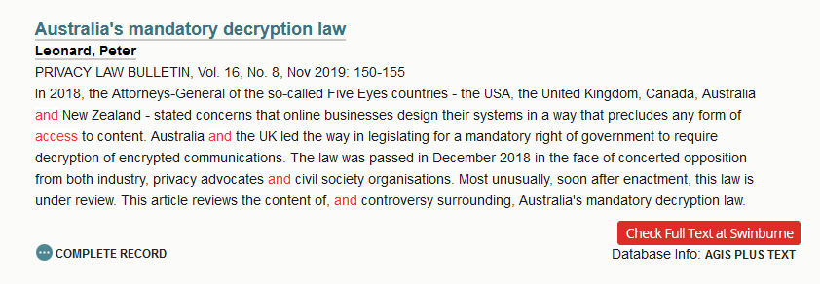
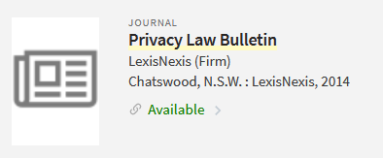

Search a database: AGIS Plus Text (Attorney General’s Information Service Australia)

Slide 28
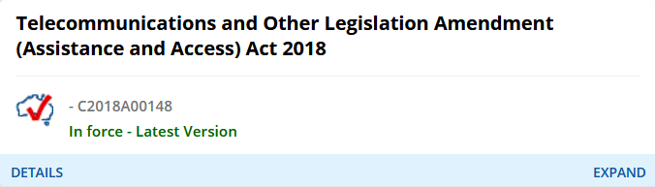
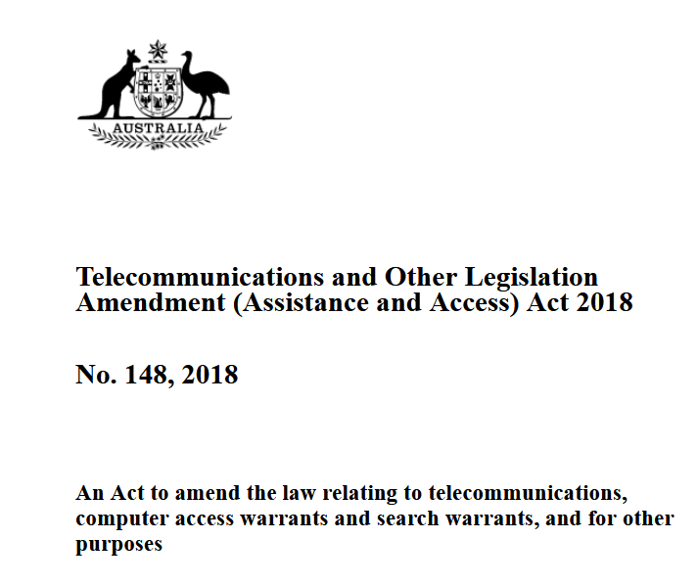
Find legislation: Federal Register of Legislation: https://www.legislation.gov.au/

